Slide 1
IRI Mobile Measuring
CEE508: Pavement Rehabilitation and Maintenance
GROUP 5
Watheq, Sina, Juan Pablo

Slide 2

Introduction
Roadway network is a very important asset
Good management of this asset is crucial
Pavement roughness measurement is necessary
An acceptable reflection of overall pavement condition
However, can be costly; especially when frequent
Different low-cost alternatives are available
Including mobile phone apps
RoadLab Pro software
Introduction
Data Analysis
Evaluation
Conclusion

Slide 3

RoadLab Pro
A mobile phone app that reports IRI at roughly 100-m intervals
Developed by SoftTeco; funded by a World Bank project in 2018
Available for both Android and iOS
Uses kinematics to estimate IRI
Converts accelerometer data into IRI measurements
Phone should be mounted as vertically as possible
Uses GPS for location
Intended to obtain road conditions in developing countries
Introduction
Data Analysis
Evaluation
Conclusion

Slide 4
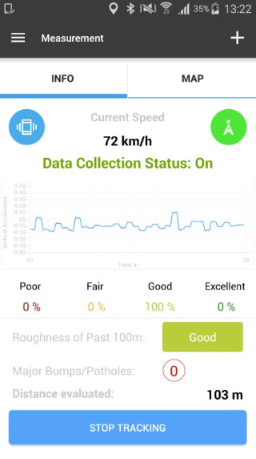
Software Overview
Driving with at least 15km/hr
Gives the option of choosing car's suspension
Hard
Soft
SUV
Custom
Takes almost continuous measurements
Reports results every 100m
Available in SI units
Open source app (free)
Can be linked to online drives (e.g. Dropbox)
RoadLab Pro Manual
Introduction
Data Analysis
Evaluation
Conclusion

Slide 5
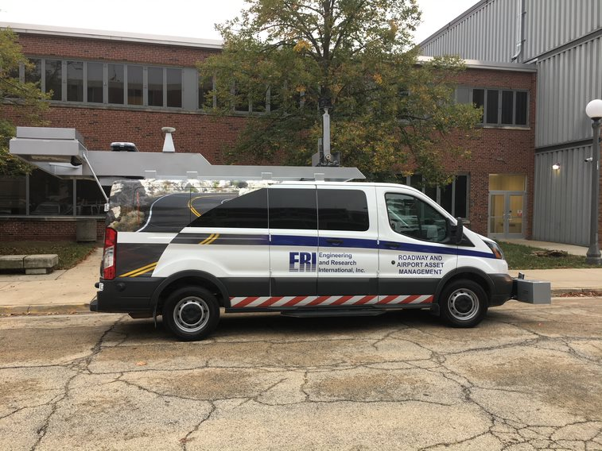
Research Motivation
Cost
Every municipal entity has a fleet of moving cars (almost no additional cost!)
Compared to around $120/mile for Data Collection
Vans (DCV)
Practicality
Simplicity compared to profilographs, etc.
Accuracy??
Can it be accurate enough for some applications?
Sina Anesteh
Introduction
Data Analysis
Evaluation
Conclusion

Slide 6


Research Objectives
Objective B: Investigate possible applications of the software based on the its respective performance through machine learning
Objective A: Assess the accuracy, capabilities of handheld measuring of IRI values
Introduction
Data Analysis
Evaluation
Conclusion
Notes:
So once we have this software for which we overall understand how it works, we want to test it. Of course, we want to measure how it performs with “Real measurements”, so we go and speak with the people at Champaign public Works. We get their professionaly measured IRI data, taken by Aptech during the summer.
But before even comparing that, do we even know if the results of the app itself are consistent? We know that there are mechanical factors that could impact accelerometer. We know there are multiple settings that could influence the measurements. How do we go about this?

Slide 7
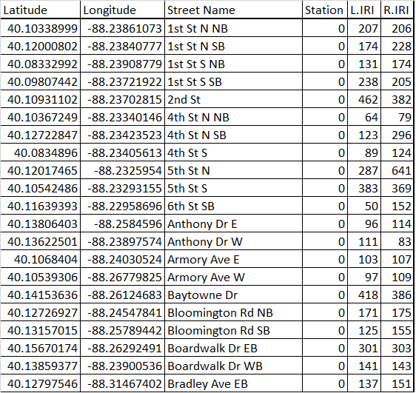
Accuracy analysis
Step 1: Compare measurements varying internal parameters.
How repeatable are the measurements?
Step 2: Compare with existing measurements
Given IRI data for the city of Champaign, how do we compare?
Introduction
Data Analysis
Evaluation
Conclusion
Notes:
So once we have this software for which we overall understand how it works, we want to test it. Of course, we want to measure how it performs with “Real measurements”, so we go and speak with the people at Champaign public Works. We get their professionaly measured IRI data, taken by Aptech during the summer.
But before even comparing that, do we even know if the results of the app itself are consistent? We know that there are mechanical factors that could impact accelerometer. We know there are multiple settings that could influence the measurements. How do we go about testing this?
We compare within our measurmenets and with champaigns.

Slide 8
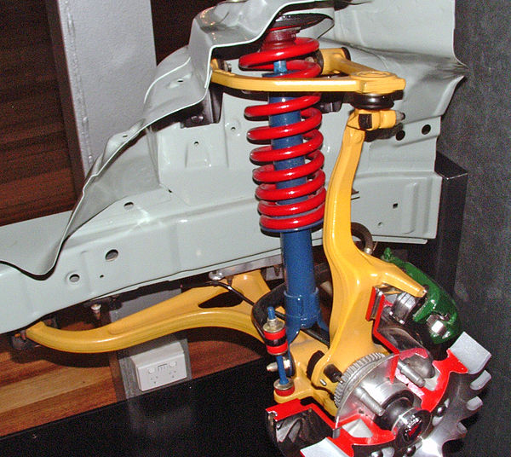


1) Variation of Internal Parameters
SUV – Sedan Speed Surface Type
Introduction
Data Analysis
Evaluation
Conclusion
Notes:
Given our limited time, we draw a scope. We will vary the following variables and analyse the impact.
Chose Car type: Due to different suspension
Choose speed: possible different impact on wavelengths captured
Surface type: Possible difference due to construction, or state of the road

Slide 9
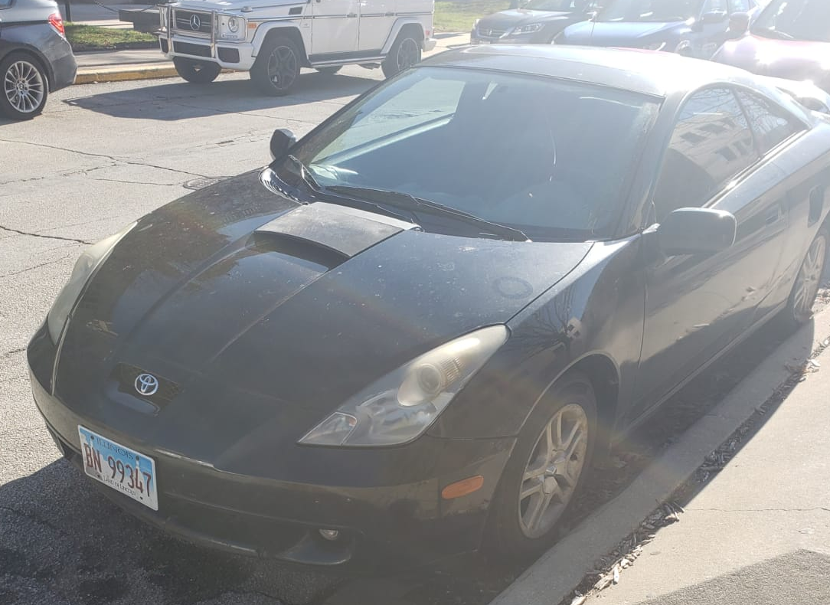
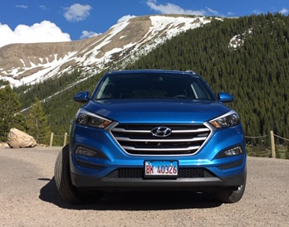
Car Type
Sedan A.K.A Black Diamond
SUV A.K.A Blue Sapphire
Introduction
Data Analysis
Evaluation
Conclusion
Notes:
First is the car type, we have the following two possibilities, an Hyundai Tucson and a Toyota Celica.
We know from the app to expect different results.
Where do we try them?

Slide 10
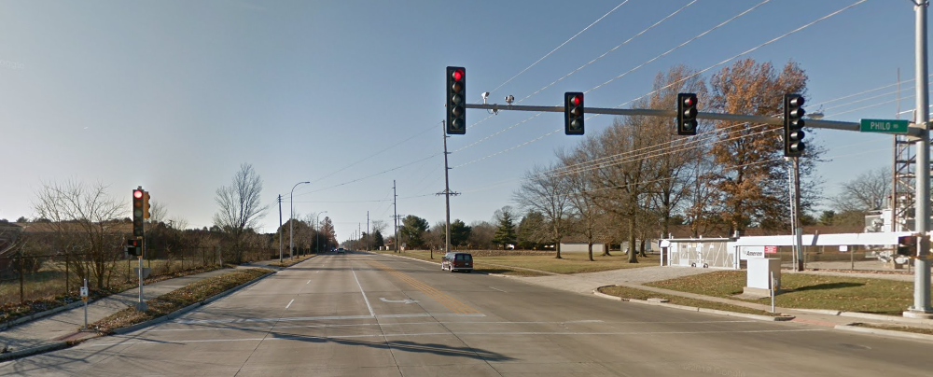
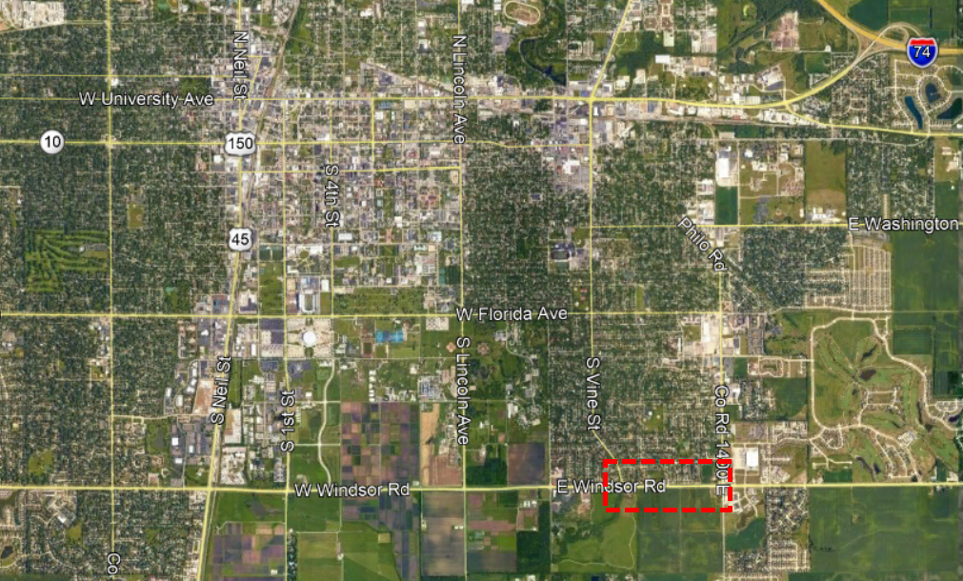
Car Type (ct’d)
Sedan A.K.A Black Diamond
SUV A.K.A Blue Sapphire
Windsor Road
Introduction
Data Analysis
Evaluation
Conclusion
Notes:
First is the car type, we have the following two possibilities, an SUV and a Sedan.
We know from the app to expect different results.
We try them on Windsor road, low traffic volume and good conditions. Southeast Champaign, 1 mile approx. between philo and vine.

Slide 11
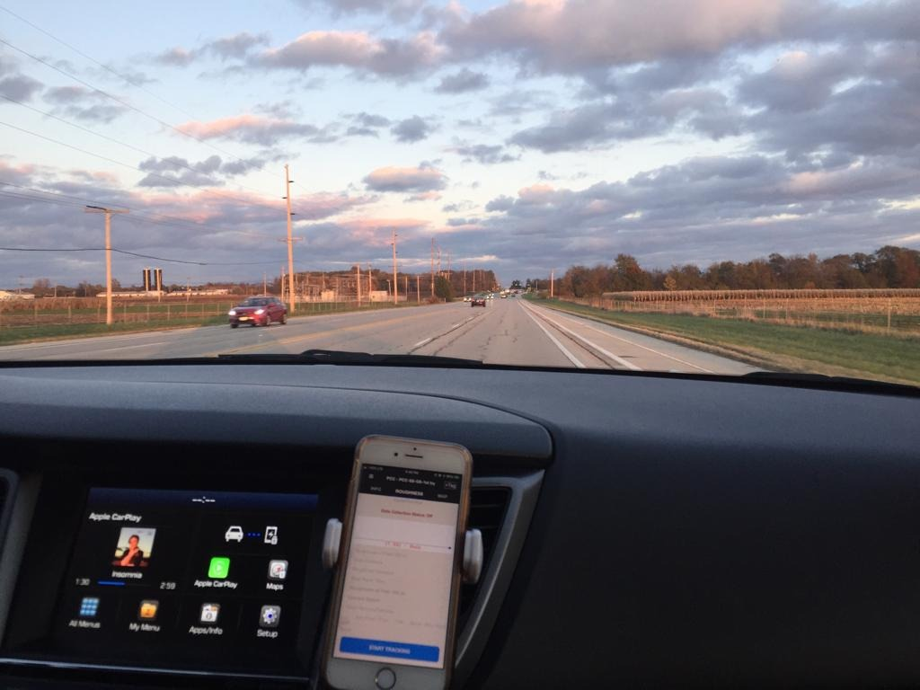
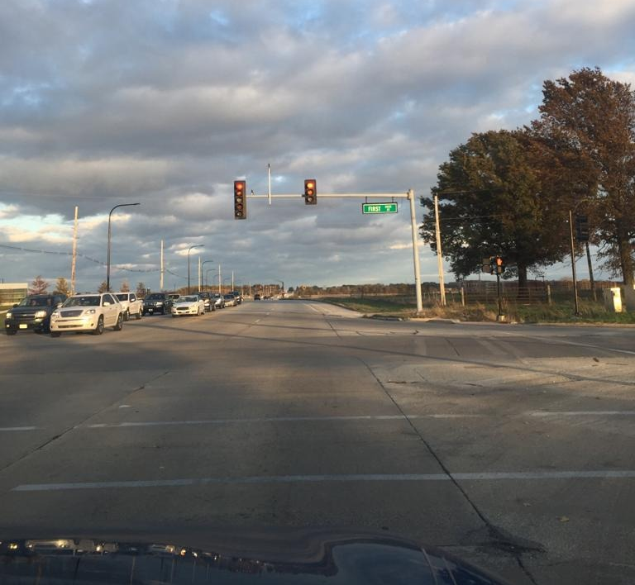
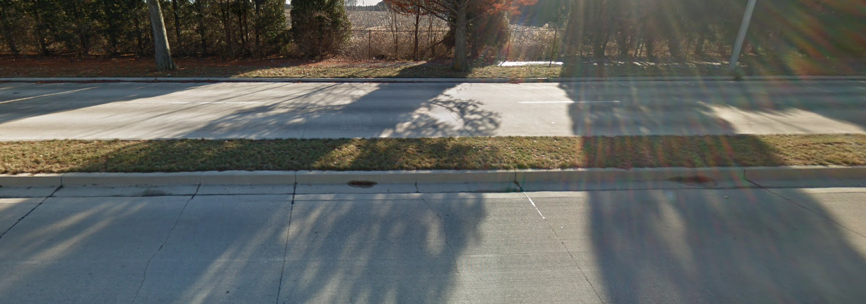
Car Type (Results)
Introduction
Data Analysis
Evaluation
Conclusion
Notes:
We see that sedan has two very similar measurements, below in candid colors.
SUV with default settings is unreasonably high.
With changed settings it is still giving high results.
Since we are getting more consistent and reasonable results with SEDAN
(recall 63*IRI(si) = in/mi)

Slide 12
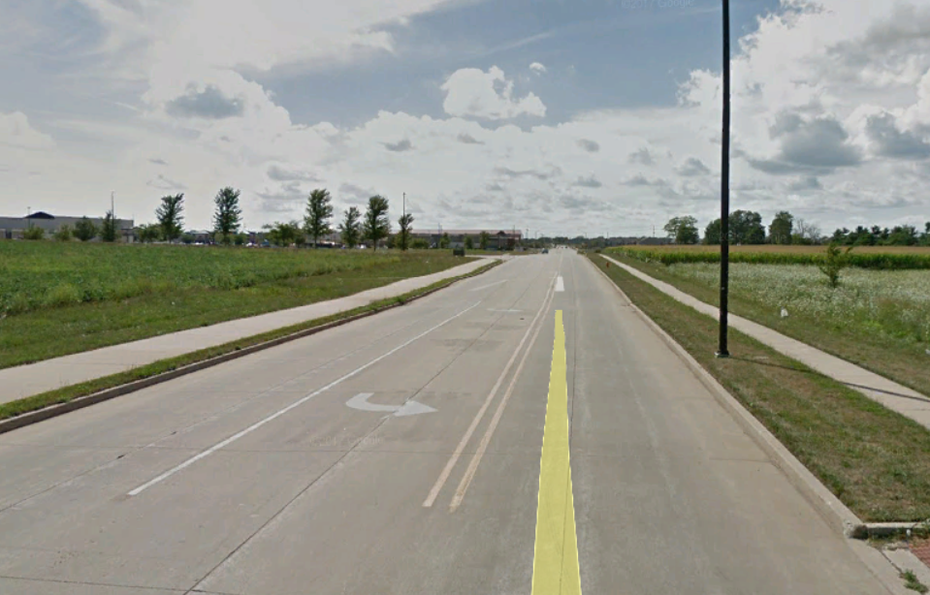
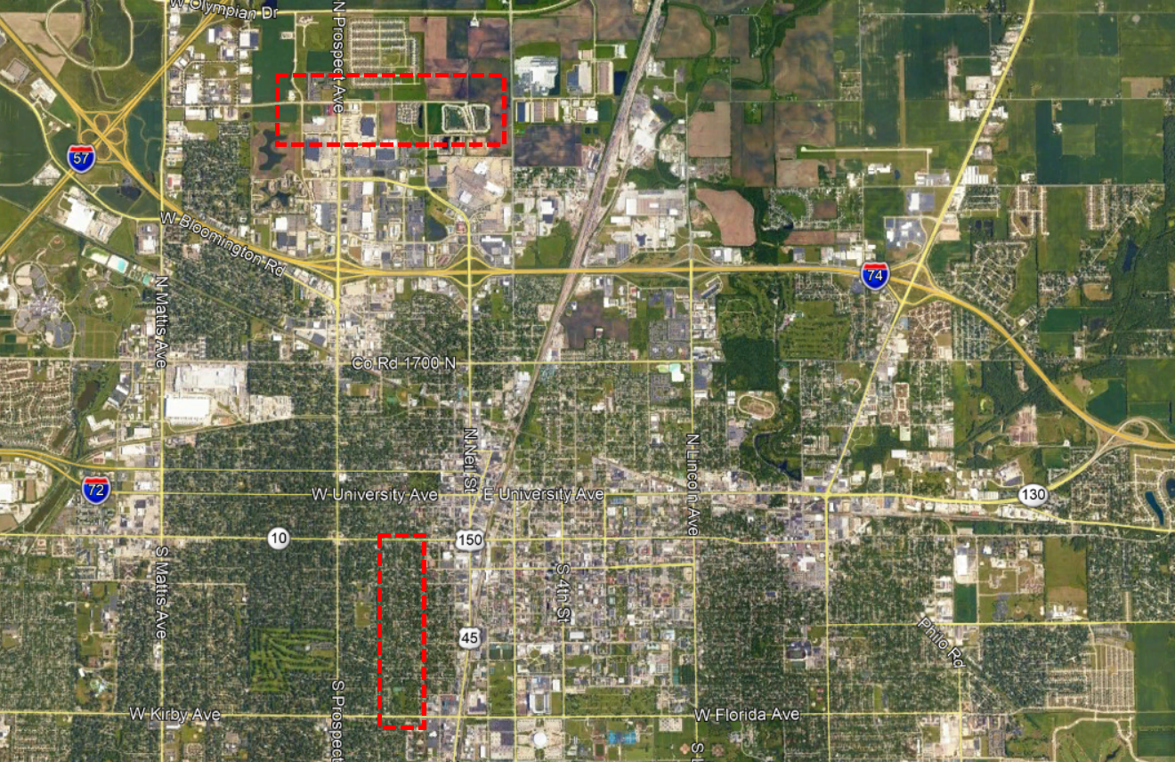
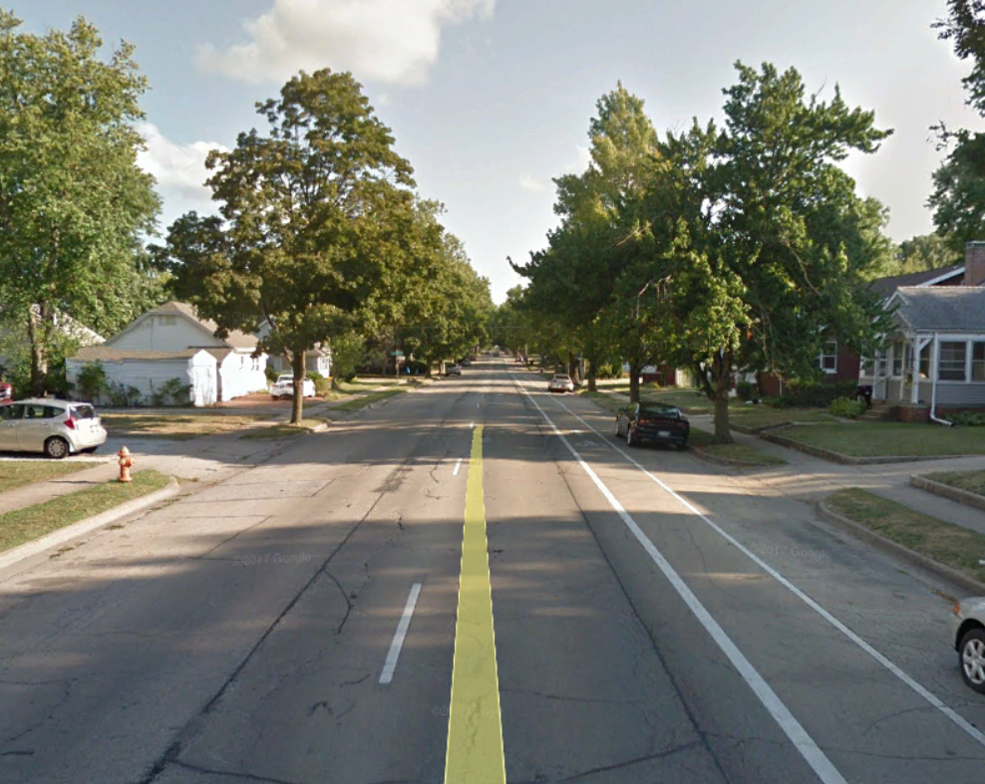
Vehicle Speed
Interstate Drive (PCI:80)
Choose Interstate Drive at north Champaign, full IRI data and low traffic. PCC.
Choose State St. Relatively low traffic and with IRI data all along. Asphalt surface and fair conditions.
State Street (PCI: 40)
Introduction
Data Analysis
Evaluation
Conclusion
Notes:
Choose two streets considering: Low traffic volumes which allow to try low speeds,

Slide 13
Vehicle Speed
Introduction
Data Analysis
Evaluation
Conclusion
Notes:
Effect of speed is double: Greater accelerations possible, but also shorter wavelengths are registered when going at lower speeds.
Overall the results are similar
However there are relevant differences (10% ) in some stretches
State Street, ACC, shows a bump collected at 30mph not detected at 15mph
So here we can see a bit of the psychological part of the app: when driving at 15mph you don’t avoid any defects, when driving at 30mph you start avoiding things (improvement at the beginning) And lower wavelengths are not captured due to damping system.
Point defect in the road: At satange street theres a very noticeable sag, which produces a jump in IRI for a specific point, captured twice.

Slide 14
2) Accuracy
Introduction
Data Analysis
Evaluation
Conclusion
Notes:
Now we compare with the actual measurements from Champaign City, using a profilometer. Easier in next graph

Slide 15
Accuracy (ct'd)
Introduction
Data Analysis
Evaluation
Conclusion
Notes:
Averaging our results we see that we are not specifically very on target, but when comparing to the already existing difference between the right and left measured IRI, the averaged results are within a tolerance level of acceptance. To show this go next:

Slide 16
Relative Errors
Introduction
Data Analysis
Evaluation
Conclusion
Notes:
Averaging our results we see that we are not specifically very on target, but when comparing to the already existing difference between the right and left measured IRI, the averaged results are within a tolerance level.
How much more would it be reasonable to try to match these values?
Looking at the errors absolutely, there's a bigger “error” in State St., however in light it has bigger IRI values, we should consider that relative to the IRI value both have comparable errors.
Considering this, we explore some practical applications possible

Slide 17

City of Champaign
Meeting with Champaign Public Works, we discussed:
Scheduling
Prioritization System
Roughness Consideration
Introduction
Data Analysis
Evaluation
Conclusion
Notes:
Scheduling:
They record the condition………….each year
Then report to Council…………..for contract award, cost and scope of work
Aim to update information on a regular basis
Prioritizing:
Based on: current condition, maintenance issues and citizen inputs
Roughness Consideration:
High volume of the calls regarding maintenance requests......from citizens......for residential streets
Mainly due to ride quality…..discuss about later

Slide 18
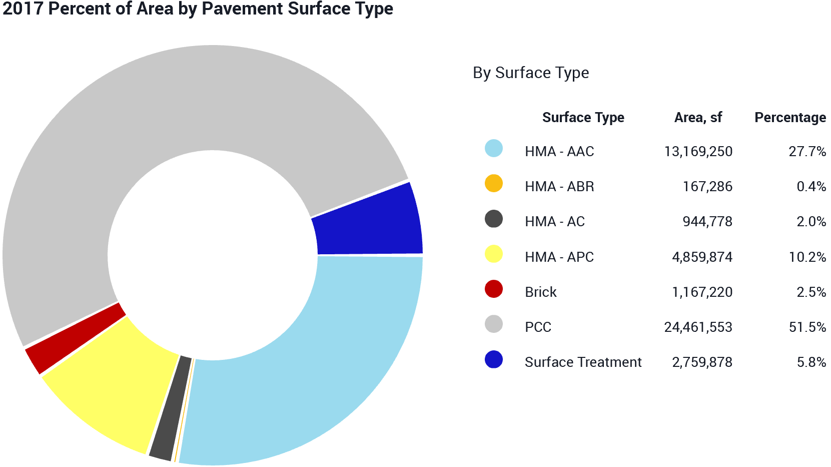
City of Champaign
AAC: Asphalt over Asphalt Concrete
ABR: Asphalt over Brick
AC: Asphalt Concrete
APC: Asphalt over Portland Cement Concrete
Introduction
Data Analysis
Evaluation
Conclusion

Slide 19
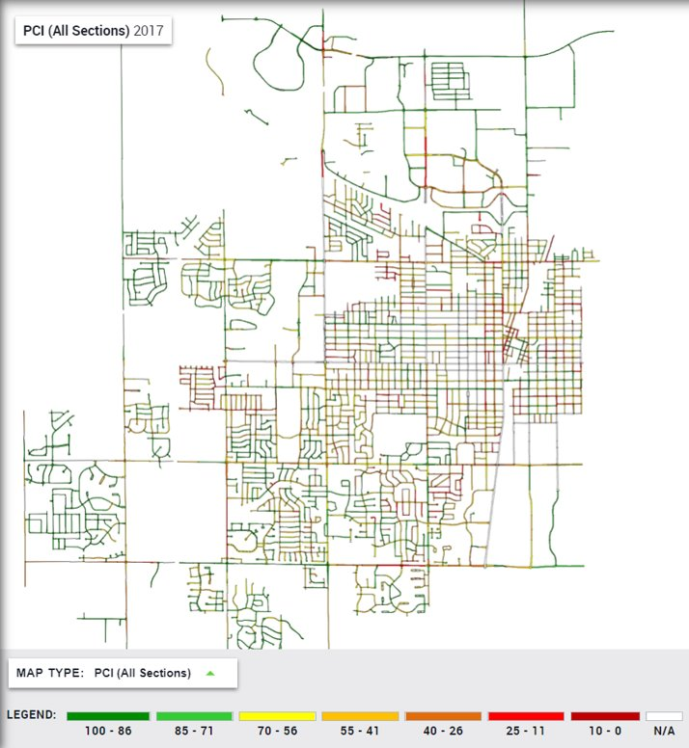
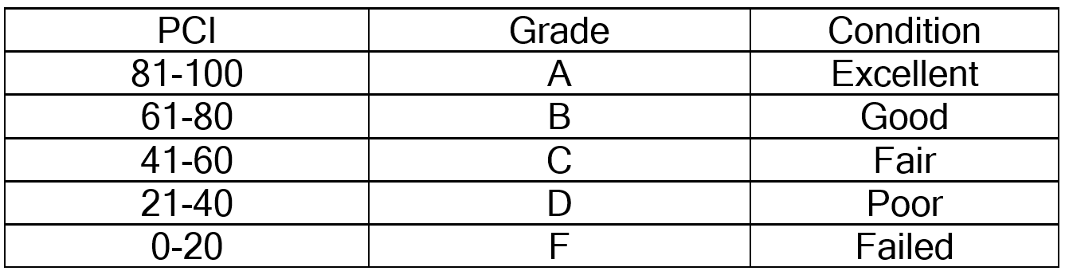
Champaign's Current Methodology
City of Champaign uses PCI (Pavement Condition Index) to evaluate pavement conditions:
Using IDEA (Interactive Data Exchange Application) to summarize the collected data
Introduction
Data Analysis
Evaluation
Conclusion
Notes:
PCI:
Latest available data is from 2017

Slide 20
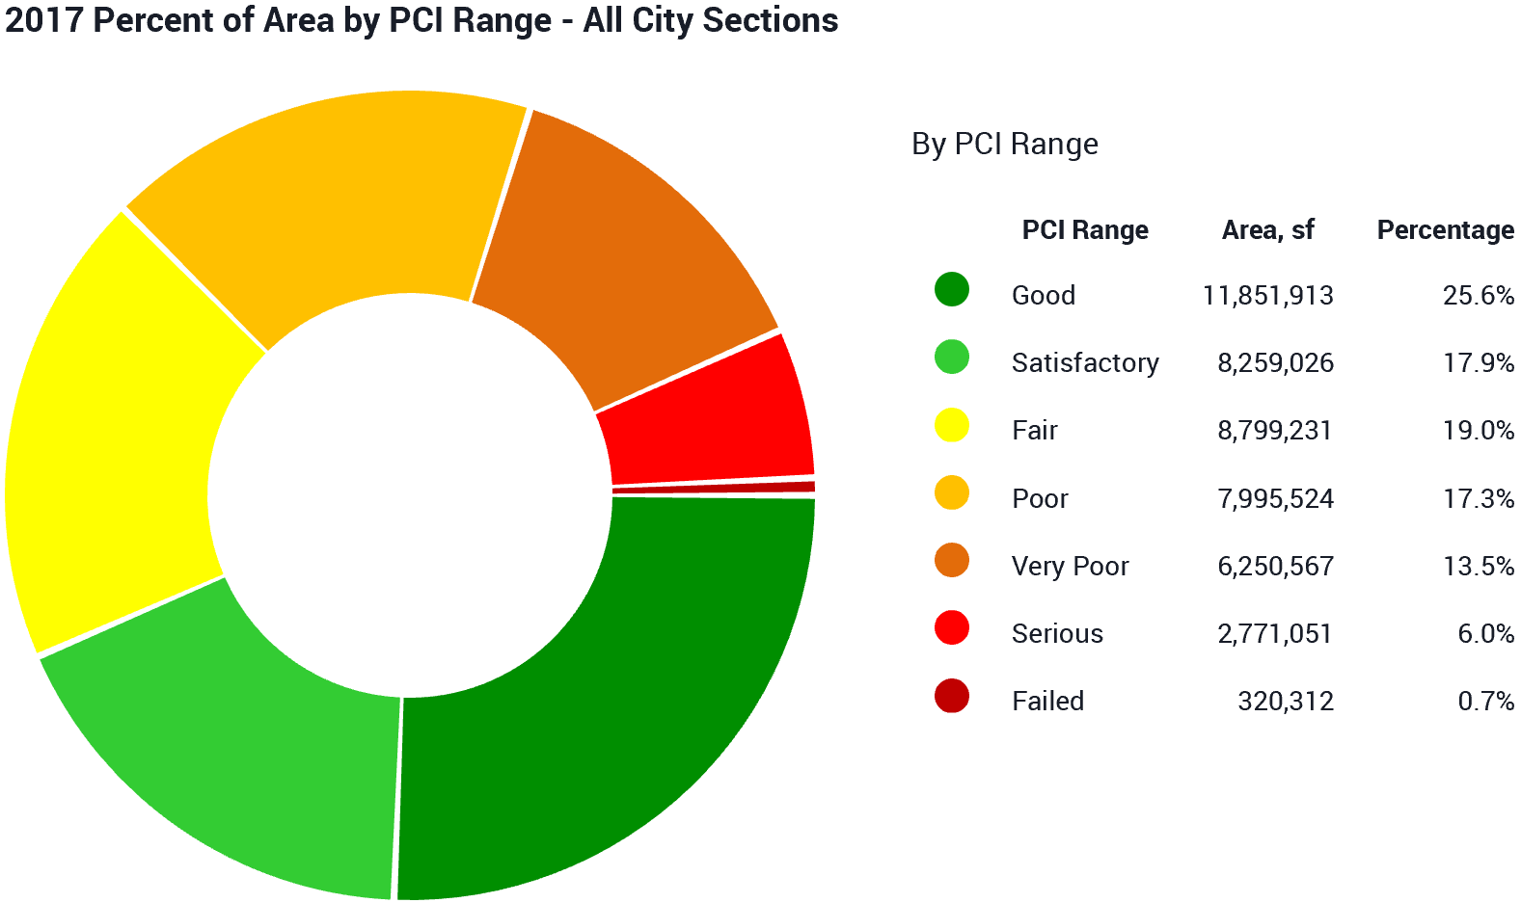
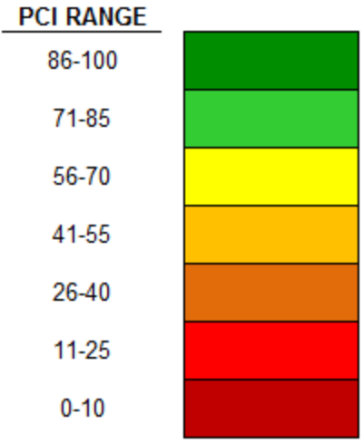
Champaign's Current Methodology
Introduction
Data Analysis
Evaluation
Conclusion

Slide 21
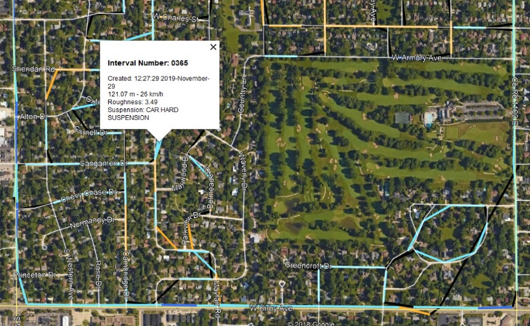
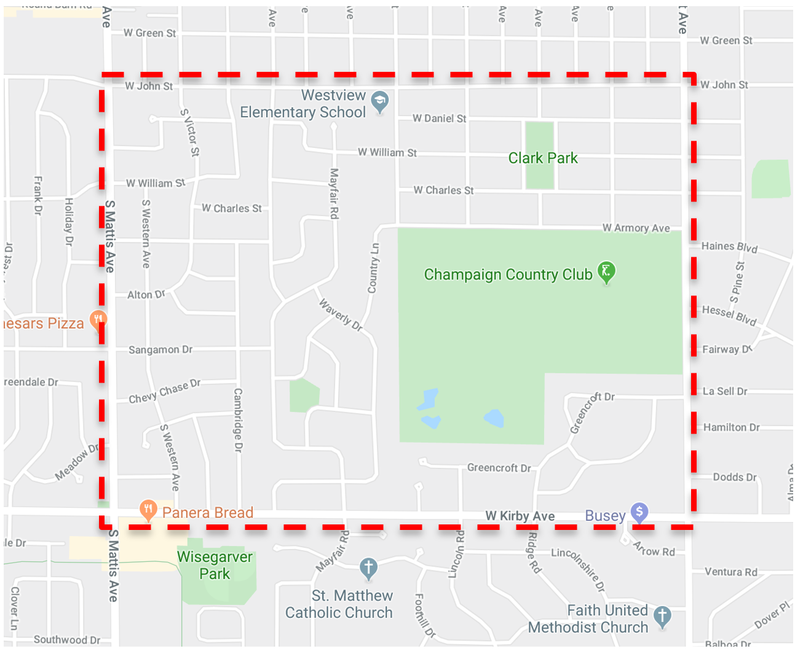
Practical Evaluation (Data Collection)
A section of the pavement network system rich in PCI data was selected:
Delimited by Kirby Ave., Mattis Ave, John St. and Prospect Ave
Having low traffic
Presenting a good wide range of PCI
To contrast IRI results obtained via the app and current available PCI measurements
Introduction
Data Analysis
Evaluation
Conclusion

Slide 22
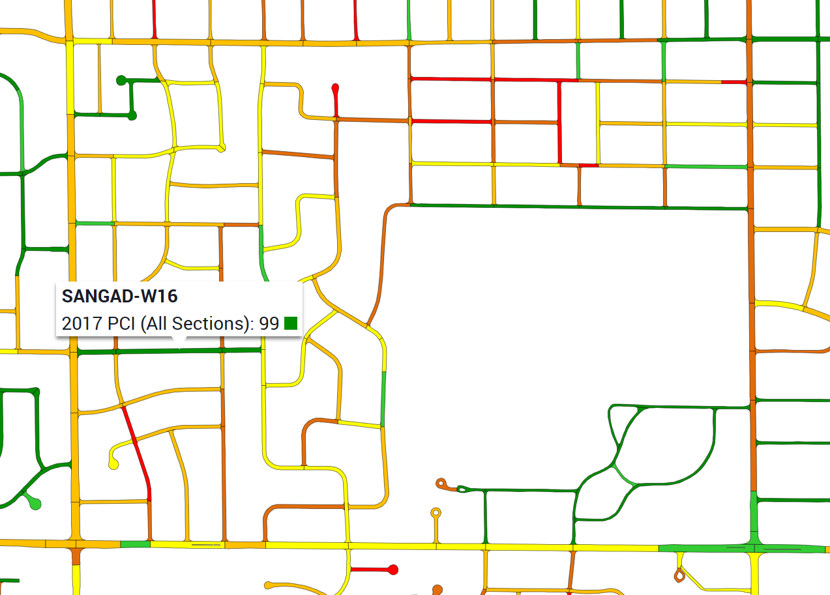
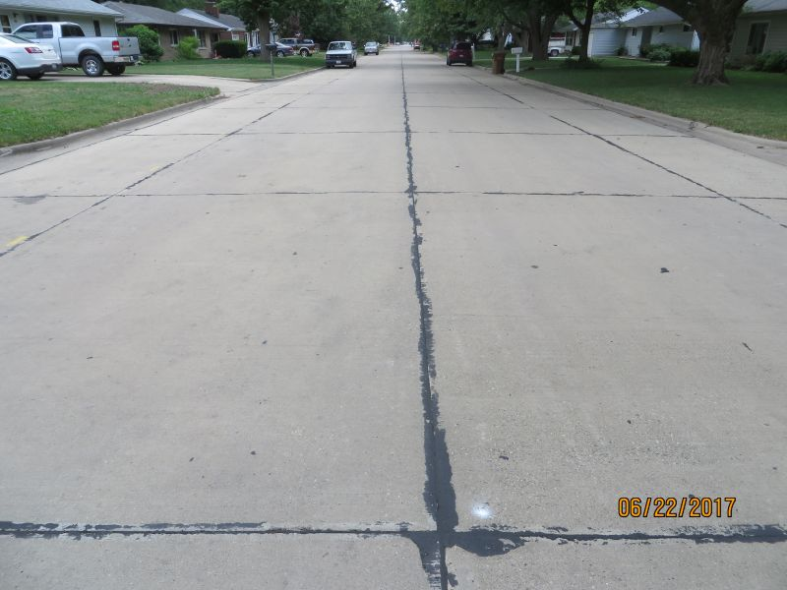
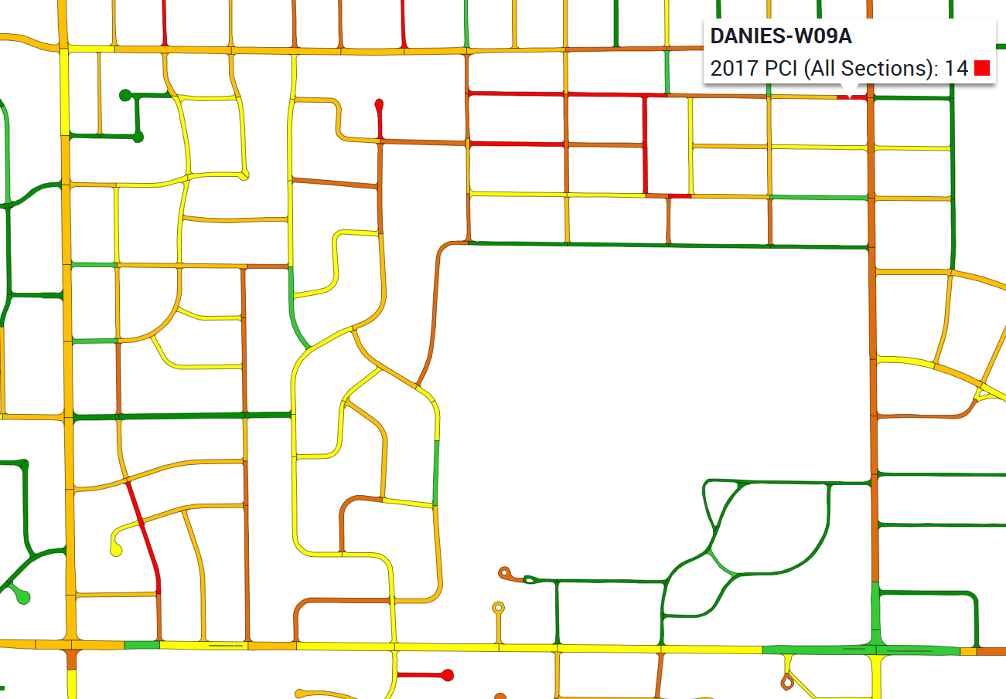
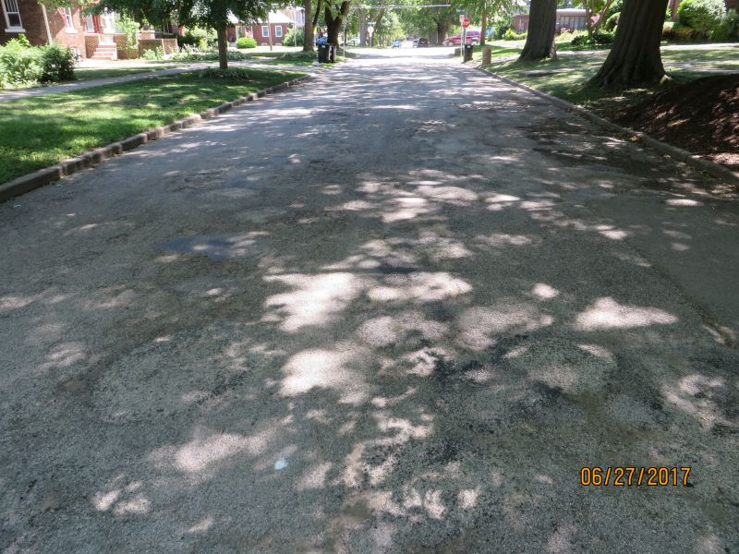
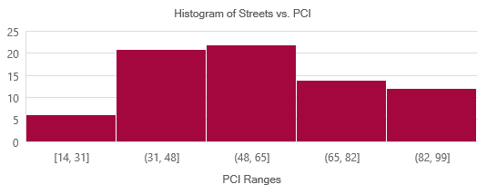
Practical Evaluation (Data Collection)
PCI range in selected section:
Max = 99 (Sangamon Dr.)
Min= 14 (Daniel St.)
Introduction
Data Analysis
Evaluation
Conclusion

Slide 23
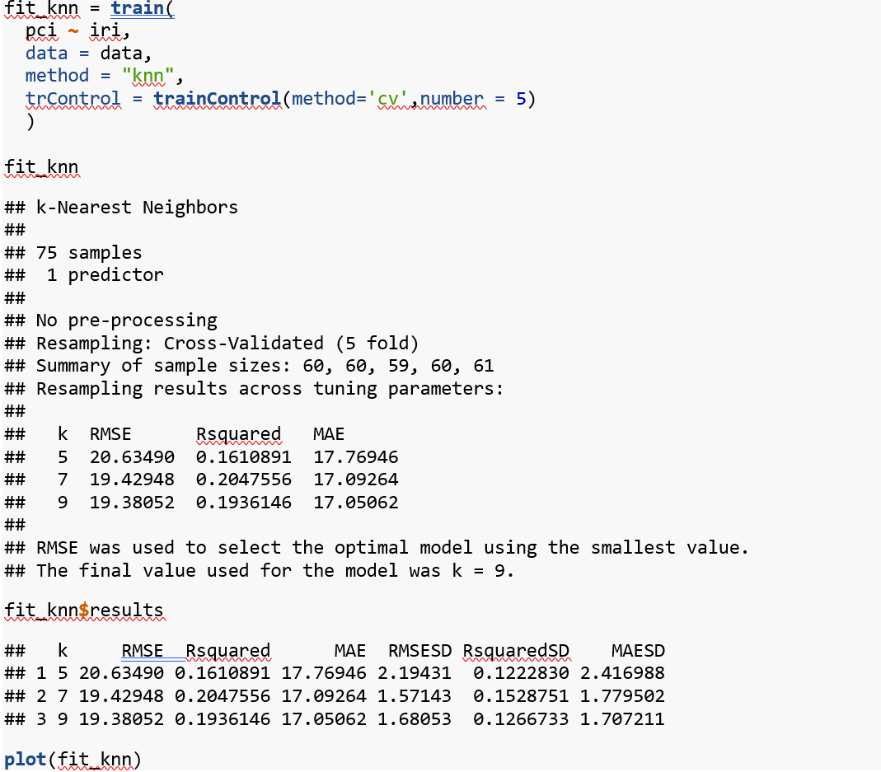
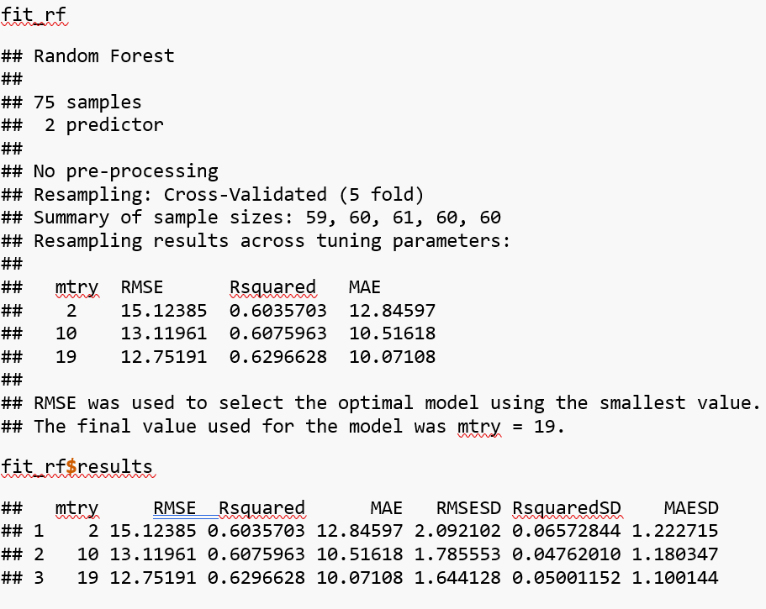
Practical Evaluation (Model Fitting)
To evaluate the capabilities of a model that predicts PCI through IRI data, we proposed:
Linear Model
K Nearest Neighbors Model
Random Forest Model
Random Forest Model fits the best
In all cases a correct correlation was evidenced, but stronger correlation on very good or very bad values of PCI
Method | RMSE | R squared | Model Parameters
Linear Regression | 18.07 | 0.236 | a = 90.56, m = -10.44
Nearest Neighbor | 18.82 | 0.237 | K = 9
Random Forest | 13.77 | 0.575 | M_{t}=19
Introduction
Data Analysis
Evaluation
Conclusion

Slide 24
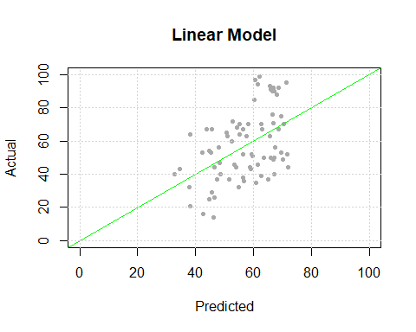
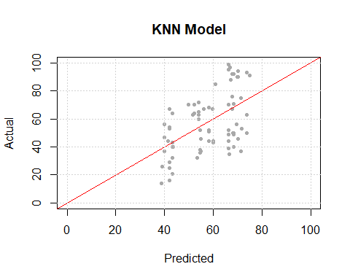
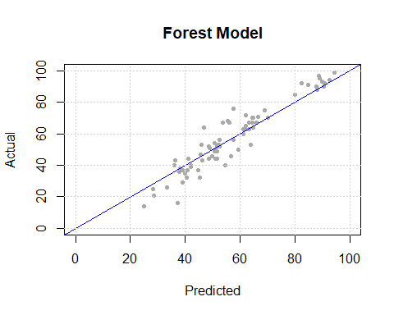
Practical Evaluation (Model Fitting)
Introduction
Data Analysis
Evaluation
Conclusion

Slide 25
Practical Evaluation (Results)
PCI is more detailed considering the actual distresses evidenced in the pavement.
Although distresses are captured to an extent by the app IRI measurement, they do not replace the PCI.
Specific issues may not be detected by a….
Ex. Pot Holes if user avoids them
In some cases, app failed to detect the road bumps
Extending the model with other data sources as well as a calibration by measuring some major roads could be the most economical and valuable methodology to enhance Champaign’s pavement management system.
Introduction
Data Analysis
Evaluation
Conclusion

Slide 26
Conclusions
Very disparate measurements between different vehicle categories (Sedan and SUV)
The final technical paper by WB is not out, we can’t qualify the model used
The algorithm may have room for improvement
Operator dependency
Keeping speed, vertical mounting, etc.
Tire pressure and other variables are not considered
e.g. vehicle categorization is very broad
Tire pressure may have an effect on the algorithm
Introduction
Data Analysis
Evaluation
Conclusion

Slide 27
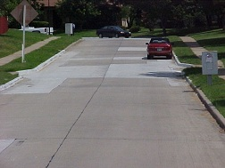
Conclusions (ct'd)
Will require a lot of work and calibrating before being widely used
Useful for local roads, track everything with same car, prioritize
Add an overhead camera, might help w/other Machine Learning
Having more accurate accelerometer data or better resolution could help
cityofnovi.org
Introduction
Data Analysis
Evaluation
Conclusion

Slide 28


Slide 29
Special Mentions:
Chris Sokolowski (CCPW)
ERI
Arturo (Aptech)
RoadLabPro

